Slide 1
TABLEAU

Slide 2
TABLEAU Overview
Tableau is a powerful and fastest growing data visualization tool used in the Business Intelligence Industry. It helps in simplifying raw data into easily understandable format.
Data analysis is very fast with Tableau and the visualizations created are in the form of and worksheets, dashboards and stories. The data that is created using Tableau can be understood by professional at any level in an organization. It even allows a non-technical user to create a customized dashboard.

Slide 3
Scope of Visual Analytics
Information Analytics
Geospatial Analytics
Scientific Analysis
Knowledge Discovery
Data Management and Knowledge Representation
Interactive Analysis
Presentation, Production and Discovery

Slide 4
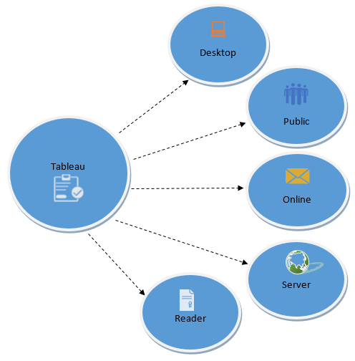
TABLEAU PRODUCTS

Slide 5
Tableau Desktop
Tableau Desktop has a rich feature set and allows you to code and customize reports. Right from creating the charts, worksheets, to blending them all together to form a dashboard, all the necessary work is created in Tableau Desktop.
For live data analysis, Tableau Desktop provides connectivity to Data Warehouse, as well as other various types of files. The workbooks and the dashboards created here can be either shared locally or publicly.

Slide 6
Tableau Public
It is Tableau version specially build for the cost-effective users. By the word "Public," it means that the workbooks created cannot be saved locally, in turn, it should be saved to the Tableau's public cloud which can be viewed and accessed by anyone.
There is no privacy to the files saved to the cloud since anyone can download and access the same. This version is the best for the individuals who want to learn Tableau and for the ones who want to share their data with the general public.

Slide 7
Tableau Server
The software is specifically used to share the workbooks, visualizations that are created in the Tableau Desktop application across the organization. To share dashboards in the Tableau Server, you must first publish your work in the Tableau Desktop. Once the work has been uploaded to the server, it will be accessible only to the licensed users.
However, It's not necessary that the licensed users need to have the Tableau Server installed on their machine. They just require the login credentials with which they can check reports via a web browser. The security is high in Tableau server, and it is much suited for quick and effective sharing of data in an organization.

Slide 8
Tableau Online
As the name suggests, it is an online sharing tool of Tableau. Its functionalities are similar to Tableau Server, but the data is stored on servers hosted in the cloud which are maintained by the Tableau group.
There is no storage limit on the data that can be published in the Tableau Online. Tableau Online creates a direct link to over 40 data sources that are hosted in the cloud such as the MySQL, Hive, Amazon Aurora, Spark SQL and many more.
To publish, both Tableau Online and Server require the workbooks created by Tableau Desktop. Data that is streamed from the web applications say Google Analytics, Salesforce.com are also supported by Tableau Server and Tableau Online.

Slide 9
Tableau Reader
Tableau Reader is a free tool which allows you to view the workbooks and visualizations created using Tableau Desktop or Tableau Public. The data can be filtered but editing and modifications are restricted. The security level is zero in Tableau Reader as anyone who gets the workbook can view it using Tableau Reader.
If you want to share the dashboards that you have created, the receiver should have Tableau Reader to view the document.

Slide 10
Database Supported by Tableau
Spreadsheet
Database (MySql, Sql Server, MongoDb etc)
Big Data
Cloud Database
Data warehouse
+ 50 different databases

Slide 11
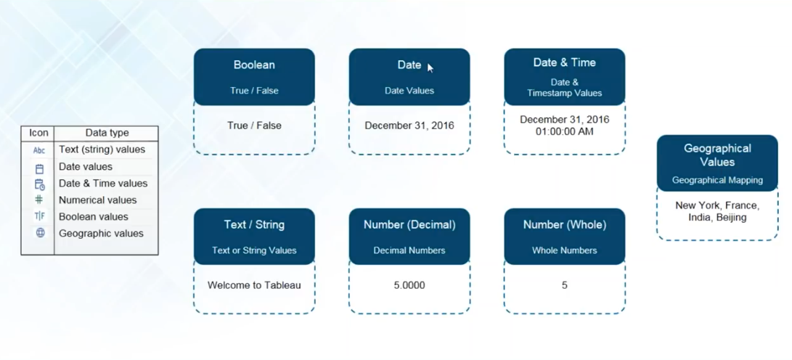
Tableau Data Types

Slide 12
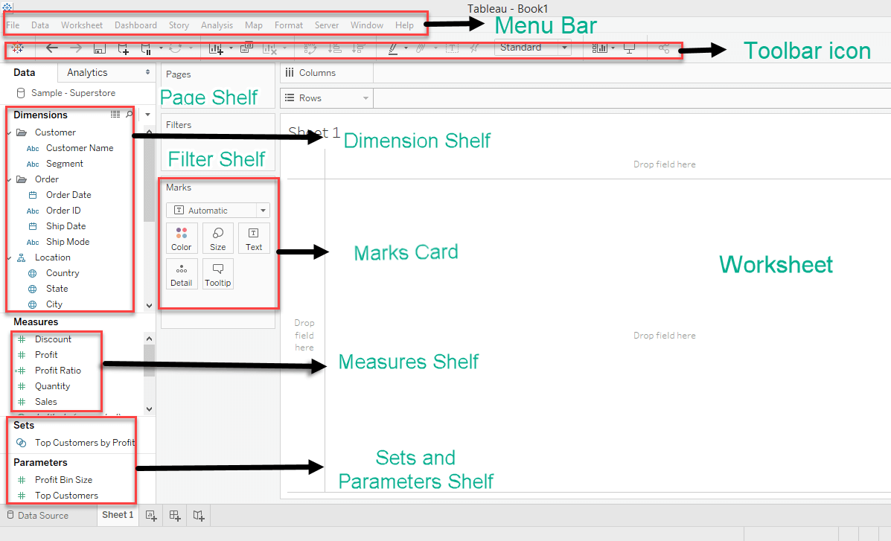
Tableau Navigation Window

Slide 13
Understanding Tableau UI
Once we connect to a data source in tableau, the columns get divided into dimensions and measures.
Dimensions - A dimension is a field that is an independent variable. It mostly consist of textual data
Measures - A measure is a field that is an dependent variable. It mostly consist of numerical data. Its value is a function of one or more dimensions.
Show Me – It shows all the possible visualizations available for our data source. The visualizations that are highlighted are the ones that are currently available

Slide 14
Marks Card - Marks card can be used to design the visualization. The data components of the visualization such as color, size, shape, path, label, and tooltip used in the visualizations can be modified in the marks card.
Page Shelf - Page shelf can be used to view the visualization in video format by keeping the relevant filter on the page shelf.
Filter Shelf - The filters that can control the visualization can be placed on the filter shelf, and the required dimensions or measures can be filtered in.

Slide 15
Sets and Parameters Shelf - The user-defined sets and parameters can be viewed in the sets and parameter shelf. It can also be used to edit the existing sets and parameters.
Worksheet - The worksheet is the place where the actual visualization can be viewed in the workbook. The design and functionalities of the visual can be viewed in the worksheet.
Toolbar Icon - Toolbar icon present below the menu bar can be used to edit the workbook using different features such as undo, redo, save, new data source, slideshow and so on.

Slide 16
Tableau Navigation
Data Source - The addition of new data source of modification of existing data source can be done using the 'Data Source' tab present at the bottom of the Tableau Desktop Window.
Current Sheet - Current Sheet can be viewed with the name of the sheet. All the sheets, dashboards and story board present in the workbook can be viewed here.
New Sheet - The new sheet icon present in the tab can be used to create a new worksheet in the Tableau Workbook.
New Dashboard - The new dashboard icon present in the tab can be used to create a new dashboard in the Tableau Workbook.
New Storyboard - The new storyboard icon present in the tab can be used to create new storyboard in the Tableau Workbook.

Slide 17
Tableau - Types of Charts
Bar Chart
Stacked Bar chart
Pie Chart
Line Chart
Scattered Chart
Packed Bubble Chart
World Map
Tree Map
Waterfall Chart
Country Map
State Map
Area Chart
Box and Whisker Chart
Area Charts
Histogram
Highlight Table
Heat Map
Word Map
etc

Slide 18
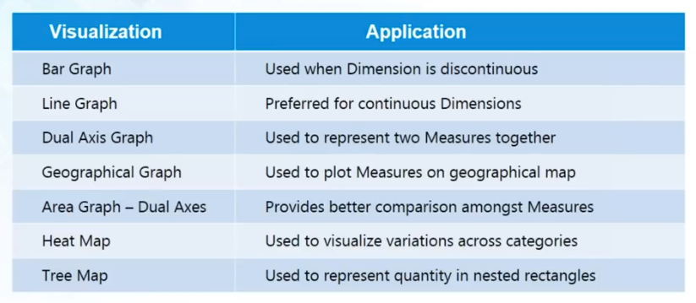
Tableau Visualizations

Slide 19
Tableau Features and Limitations
Advantages
Disadvantages
Interactive visualizations
Can handle large amounts of data.
Real time analysis.
Data Blending
Integration of different datasets.
Flexibility
Intuitive Platform
Scaling and Pricing for Enterprise.
Poor versioning.
Poor After-Sales Support

